Slide 1
Patient-facing Tool
Data (system output)
Patient Identification
Patient first and last name
Outcome Prompts
First nine PHQ questions
(Optional) tenth PHQ question if sum of first nine is >0
Other Data
Current mm/dd/yyyy
(Chris) “patient-centered messaging to encourage completing and an understanding of how their input will help therapy be successful”
Functions (user input)
Outcome Responses
Answer first nine PHQ questions
(Optional) answer tenth PHQ question
Key comments/questions
Is this tool likely based on eScreening or BHL?
Does the tool need to be responsive (fits all screens/devices)?
Does the tool need to be accessible (meets Section 508 Accessibility Guidelines)?
1
Or is this >4, per a trend line graph’s notes from Dr. Crowe?
Tenth PHQ question: “How difficult have these problems made it for you to do your work, take care of things at home, or get along with other people?”
Is the education content always in view? Maybe just if clicked? Maybe just for initial few sessions and then available if clicked? Is patient forced to view it if they don’t complete the entire PHQ? Is it available on-screen and/or in printout? Etcetera.
Ideally, these responses are entered by patient but sometimes by psychotherapy provider or other clinical staff
1
2
2
3
3

Slide 2
IN-SESSION TOOL (same day as session – before, during or after session)
Data (system output)
(Janey) only include data items needed to inform decision making for a one-on-one therapy session, aimed at treating major depression (MVP)
Embed data that’s the same or similar to Analytics Tool Data, or (auto?) link to Analytics Tool
Functions (user input)
Embedded or link to chart of previous + current scores
Topic of current session (required field)
Pick from list plus option of “Other: free form entry” (this might be only in pilot, per Dr. Crowe)
Maybe default to purpose of entire episode of care, e.g., Depression
Intervention performed in current session (required field)
Jeanne’s of interventions and procedures
Pick from list plus option of “Other: free form entry” (this might be only in pilot, per Dr. Crowe)
Homework assignment, e.g., PHQ, anxiety measures (like GAD-7, above), alcohol consumption (required field)
Session Note (required field)
Session printout for patient
Time/Date of all inputs (automate this)
Key comments/questions
Input likely done via Reminder dialog in CPRS
Can user pick Topics and Interventions from a dropdown?
Can the list items for Topics and Interventions be grouped, possibly even made visible or enabled upon clicking a category?
Depending on technical platform, we can’t always chunk list items, can’t always do required fields
Chris design comments on 04feb
In testing, we need to verify if we have all the typical interventions (“Can they find the therapy they want to use”)
Type in a few letters and the short list will pop up
Don’t show so many checkboxes at a time
Let them pull other measures from MHA (?)
Let them enter free form text
Psychotherapy vs. (Case Management OR Crisis Management OR…)
Does the tool need to be responsive (fits all screens/devices)?
Does the tool need to be accessible (meets Section 508 Accessibility Guidelines)?
Requirements for patient panel of all patients scheduled on current day/week – these requirements are pending
1
(Chris) “review scores at a glance in a clinical context”
Is this also needed on Patient-facing Tool?
Behavioral strategies are for depression, Cognitive strategies have a lot of overlap between depression & anxiety
(Jeanne) today if I select Behavioral, then I see the strategies but don’t have to pick them … we need them to pick a strategy
(Chris) probably should combine them into one long list (Cognitive + Behavioral)
(Janey) “PHQ score + items for Note will be required to sign off note.”
Automate PHQ entry outcomes entered electronically
(Chris) “have ability to print a very brief report/therapy progress document for Veteran with an explanation of scores and suggestions/recommendations regarding what they can do to get the most benefit from therapy. Best if somewhat customizable.”
(Janey) “Do we need trackability of who entered, when they entered (i.e., information that comes with health factor?)”
2
1
2
3
4
3
4
5
5

Slide 3
ANALYTICS TOOL (could also be useful embedded or linked from In-Session Tool)
Data (system output)
Same or similar to In-Session Tool Data, or (auto?) link from In-Session Tool to Analytics Tool’s Data
Patient Identification
Patient first and last name
Patient last four digits of SSN
Other patient identifying info
Patient phone number (per Russ’s wireframes on 06feb2020)
Therapy Description
Primary reason/diagnosis for entire set of therapy sessions, or “overall episode of care”
Primary psychotherapy provider assigned to this patient for entire set of therapy sessions
Secondary psychotherapy provider conducting current session
Episode of care initiation date (auto-generated)
Session Number (x out of y prescribed sessions, auto-generated)
Other medically relevant patient data (e.g., prescribed medications, psychiatric or other)
Outcome Results
“red flag” Alerts
PHQ suicide item (details and action options)
Incomplete current PHQ
Poor treatment progress (details and action options)
(Chris) “clinical alerts … efficacy of treatment”
Current vs. historic Alerts
PHQ results
Psychotherapy provider that assigned PHQ
PHQ date for current session (this might be prior to current session date)
PHQ completion status
PHQ completion time
PHQ score (total and individual questions)
PHQ score (total and individual questions) change/comparison with respect to previous session and initial session
View of data for all sessions
Data visualization of PHQ changes over time, possibly color coding for increasing, steady, decreasing (per Russ’s wireframes on 06feb2020)
Occurrence of individual PHQ answers over time, absolute counts and relative percentages (per Russ’s wireframes on 06feb2020)
Other homework results (chart view available)
Psychotherapy provider who assigned homework
Alcohol consumption
Actionable Recommendations
Recommendations to move psychotherapy providers in line with Evidence Based Practice
Recommendations specific to treaters who already practice Evidence Based Psychotherapy
Other medically relevant patient data
Lab results
Vitals
All data can be viewed in chart or table format, with ability to toggle between chart and table
Other Data
Current session’s mm/dd/yyyy
(Janey) VA probably has requirement for this … if not, then ONC does
(Tom) Is this also needed on Patient-facing Tool?
Entire patient SSN, DOB, Mailing Address (per Russ’s wireframes on 06feb2020)
(Chris) “Psychotherapy Provider: i.e., Psychiatrist, Psychologist, Clinical Social Worker, LPC, LMFT, Intern, Student”
(Jeanne) “How are we going to get Clinician name prior to session? I am not sure MHA captures this … Unlicensed providers (GS-11 – 12 psychologists, interns, LMSWs) have a supervisor who is primary provider on encounter … the current EBP report looks at primary and secondary provider … we should have a way to link all sessions to one provider.”
(Janey) certain PHQ answers might cause an Alert … other sources like homework journaling … Alerts might imply that additional treatment plans need to be prescribed
(Chris) e.g., “if this is the third session but 5th week”
(Jeanne) “Not sure how helpful this is”
(Jeanne) “Do we want to add a range to help interpret score?”
(Jeanne) “Do we also want to add option for GAD-7?”
(Tom) Is this post-MVP when we get into conditions outside Depression, or is Anxiety so intermingled with Depression that we should include it in MVP?
1
1
2
2
3
3
4
4
5
5
6
7
6
7
8
8

Slide 4
ANALYTICS TOOL continued
Functions (user input)
Toggle between individual patient’s data and various levels of population data (e.g., clinic-level, VISN-level, national level)
Toggle between chart and table views of data
View historical, recent, or most recent views of data
Enter two (or more?) variables (e.g., potential interventions … or outcomes like PHQ score and alcohol use) to update the future (only?) views of data
Filter data by patient, primary or secondary psychotherapy provider, clinic, VISN, national, etc.
Filter data by date
Filter data by outcomes, e.g., PHQ scores, alcohol results, severity/recovery thresholds
Filter data by interventions and medication prescriptions
Filter data by episode of care focus (e.g., depression) and session-based focus (e.g., marital issues)
Print various levels/categories of data (per Russ’s wireframes on 06feb2020)
Email various levels/categories of data (per Russ’s wireframes on 06feb2020)
Acknowledge, Reroute, Sort data (per Russ’s wireframes on 06feb2020)
Messaging, Scheduling, Ordering (per Russ’s wireframes on 06feb2020)
Key comments/questions
Input likely done via Reminder dialog in CPRS
Can user pick Topics and Interventions from a dropdown?
Can the list items for Topics and Interventions be grouped, possibly even made visible or enabled upon clicking a category?
Depending on technical platform, we can’t always chunk list items, can’t always do required fields
Chris design comments on 04feb
In testing, we need to verify if we have all the typical interventions (“Can they find the therapy they want to use”)
Type in a few letters and the short list will pop up
Don’t show so many checkboxes at a time
Let them pull other measures from MHA (?)
Let them enter free form text
Psychotherapy vs. (Case Management OR Crisis Management OR…)
Does the tool need to be responsive (fits all screens/devices)?
Does the tool need to be accessible (meets Section 508 Accessibility Guidelines)?
Requirements for patient panel of all patients scheduled on current day/week – these requirements are pending

Slide 5
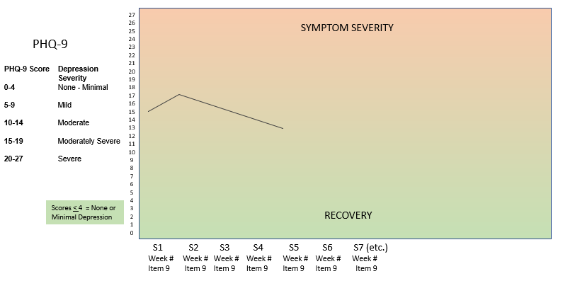
CHARTS AND OTHER VISUALS
The chart below provided by Dr. Crowe on 28jan … 02feb, he said end user needs to be able to enter two variables (e.g., potential interventions … or outcomes like PHQ score and alcohol use) to update the chart (do we need to support more than just two?)
Possible next best options for this patient….

Slide 6
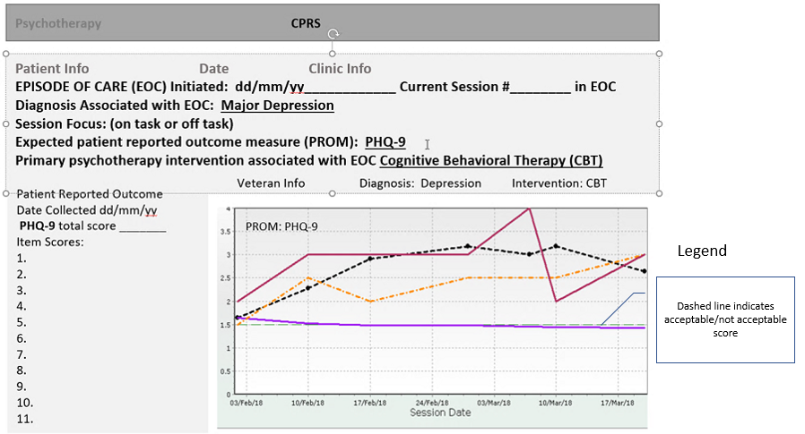
CHARTS AND OTHER VISUALS, continued
The layout below is based on CPRS and would include the CPRS Note module below the chart.

Slide 7
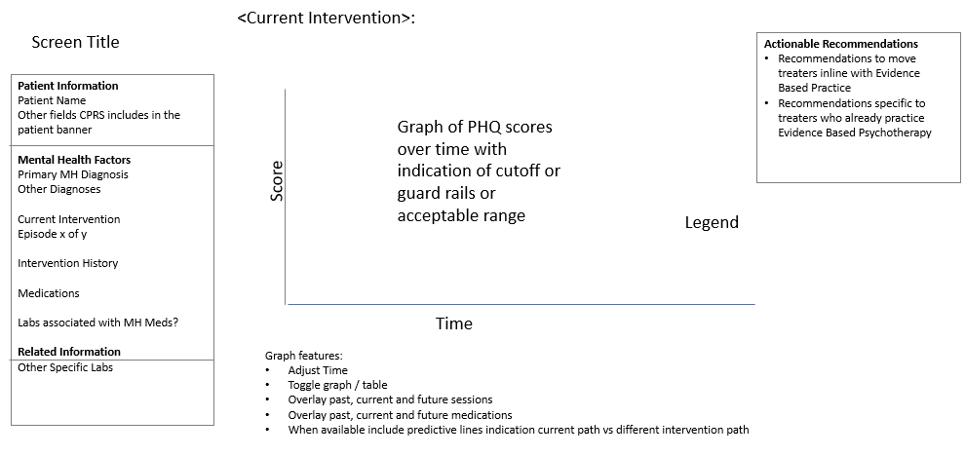
CHARTS AND OTHER VISUALS, continued
Analytics chart below provided by Janey & Chris

Slide 8
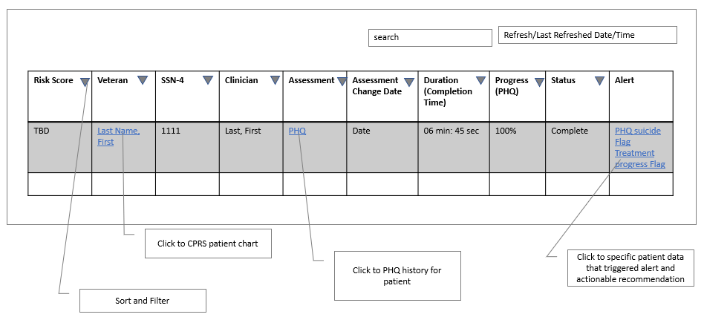
CHARTS AND OTHER VISUALS, continued
The patient panel table below provided by Janey based on eScreening

